Slide 1
Predictive Modelling of Holiday Package
Purchase Using Logistic Regression
Prepared By:
Dhanush K B
PGDM – Business Analytics
2511412

Slide 2
Business Problem Statement:
A tour and travel agency aims to increase the sales of its holiday packages. However, marketing these packages to every employee is costly and often ineffective. By understanding customer characteristics, the company can identify employees who are more likely to purchase a holiday package and focus its marketing efforts accordingly.
Goal:
Develop a predictive model that can determine whether an employee is likely to purchase a holiday package based on demographic and personal attributes such as salary, age, education level, number of children, and foreign status.

Slide 3
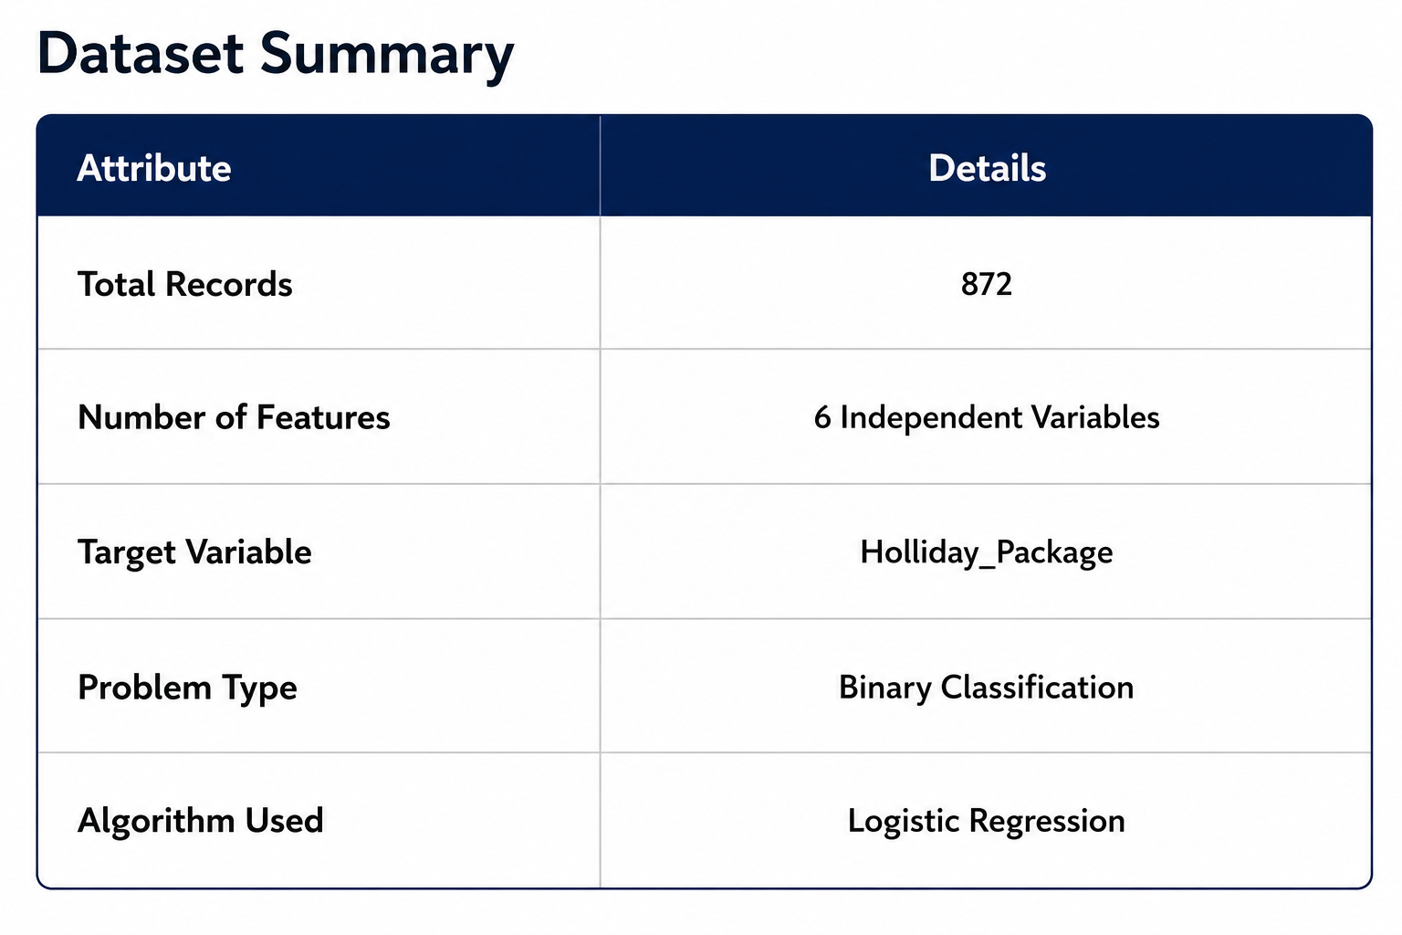
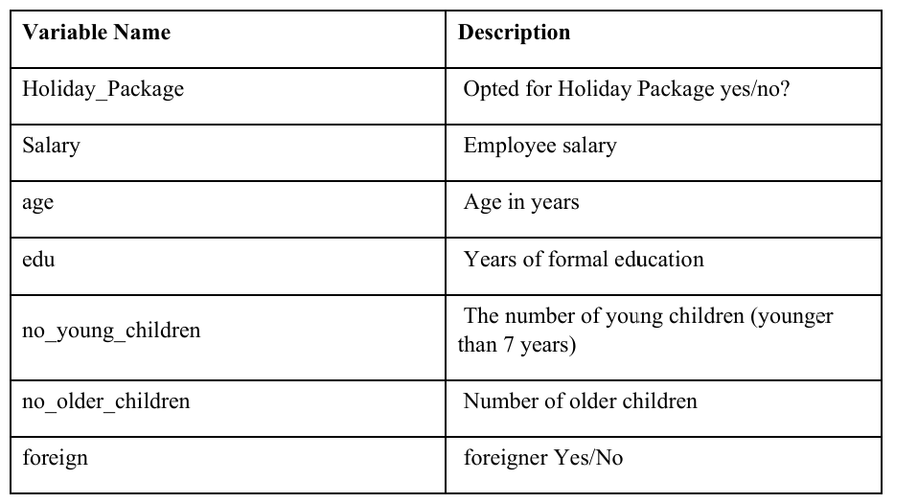
Dataset Overview:
The dataset contains information about 872 employees of a company. It includes demographic and personal attributes that are used to predict whether an employee will purchase a holiday package offered by a tour and travel agency.

Slide 4
Data Preprocessing:
Preprocessing Steps Performed:
Checked the dataset for missing values.
Verified and removed duplicate records (if any).
Performed outlier detection using the IQR method.
Defined independent variables (X) and the target variable (y).
Split the dataset into 80% training data and 20% testing data.
Features Used for Model Training
Independent Variables (X):
Salary
age
educ
no_young_children
no_older_children
foreign
Target Variable (y):
Holliday_Package

Slide 5
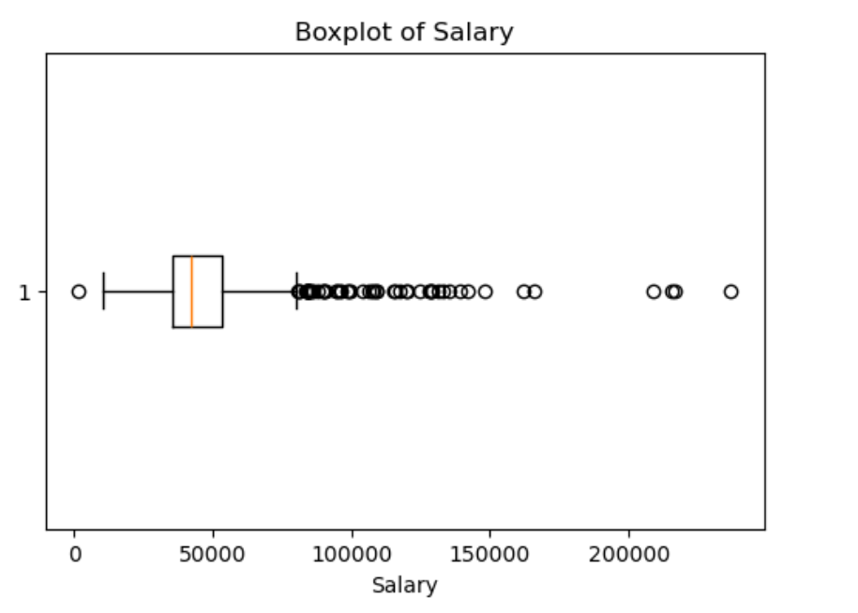
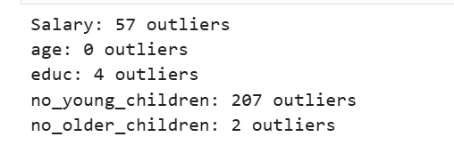
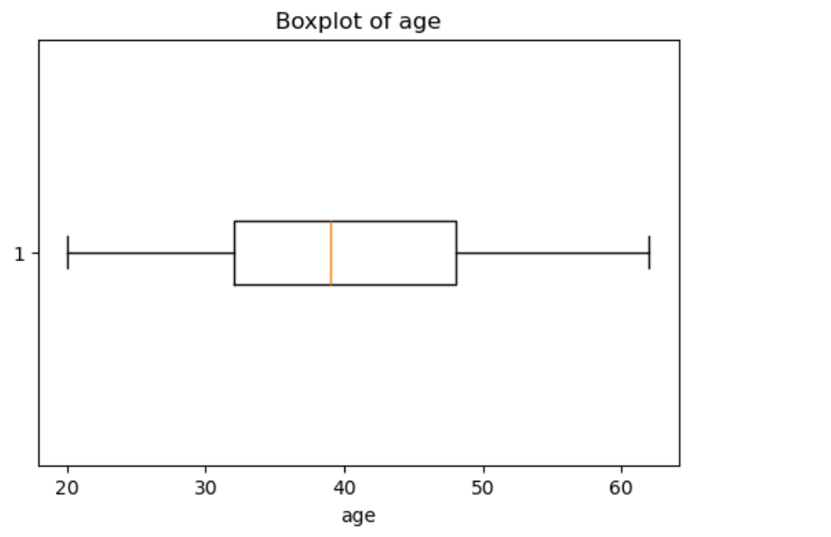
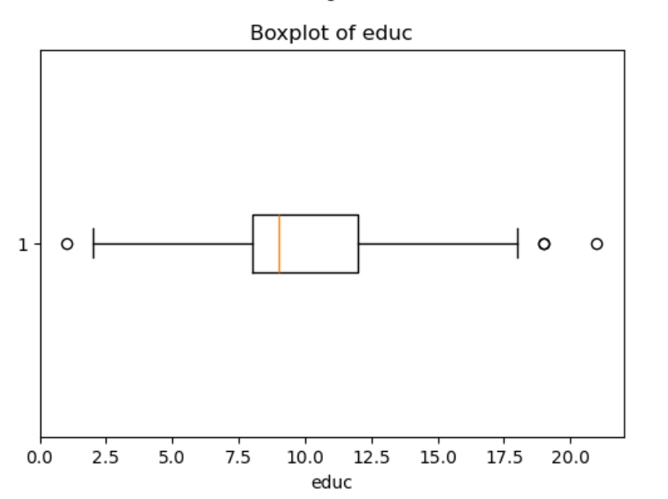
Data Preprocessing:

Slide 6
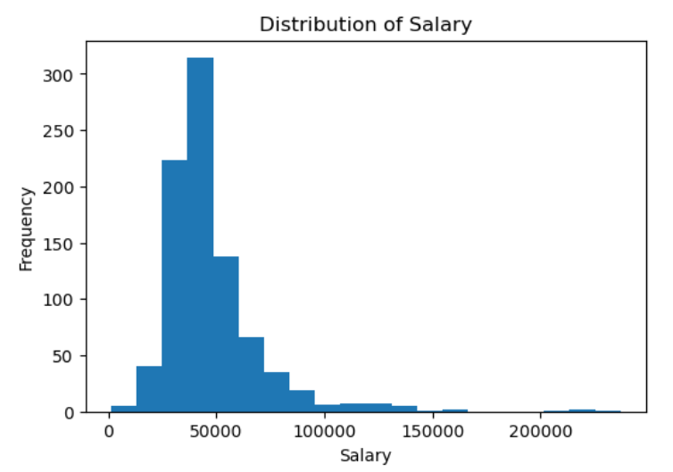
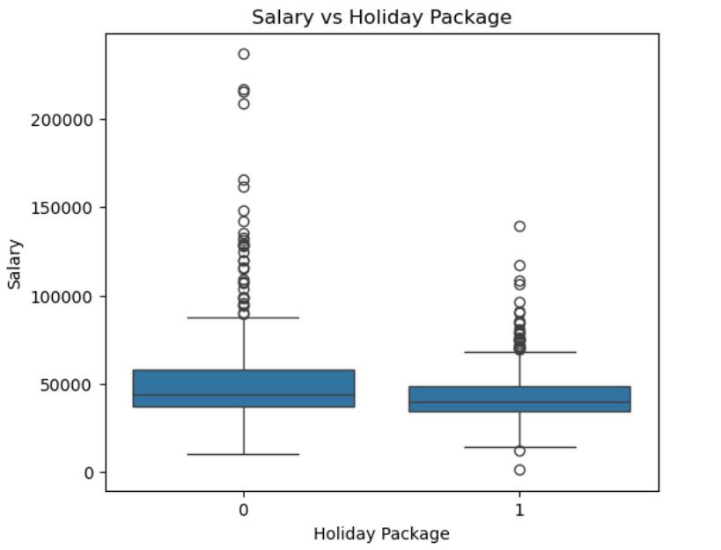
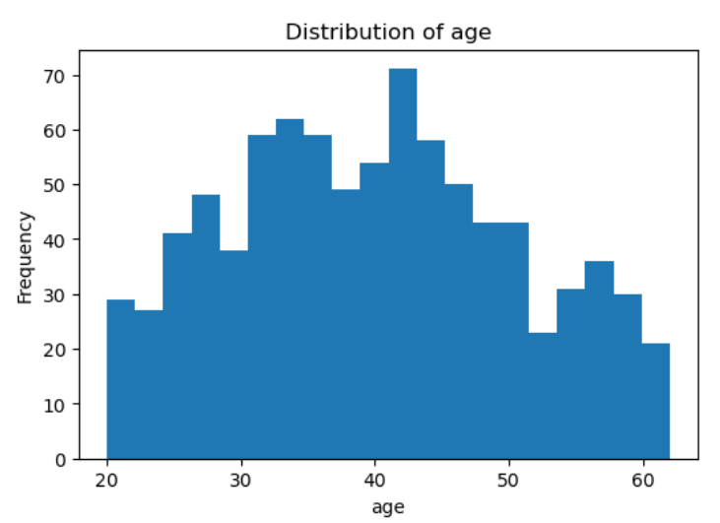
Exploratory Data Analysis (EDA)
Salary Distribution
Holiday Package vs. Salary
Age Distribution

Slide 7
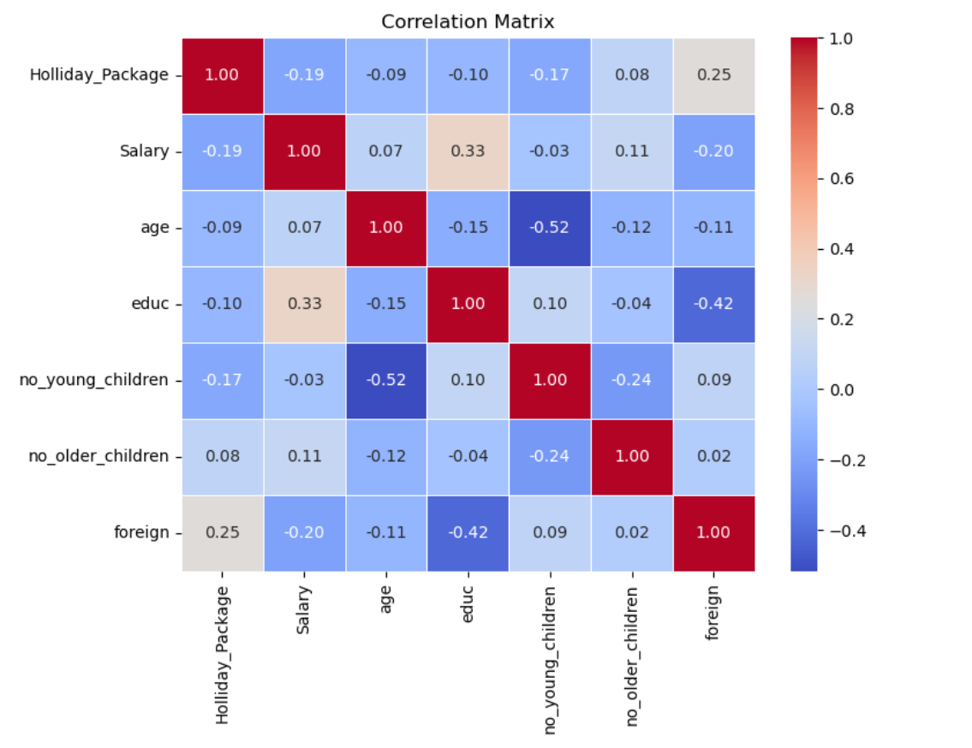
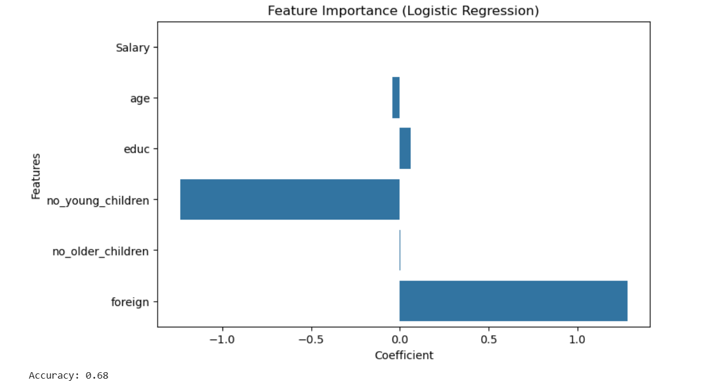
Exploratory Data Analysis (EDA)
Correlation Heatmap
Feature:

Slide 8
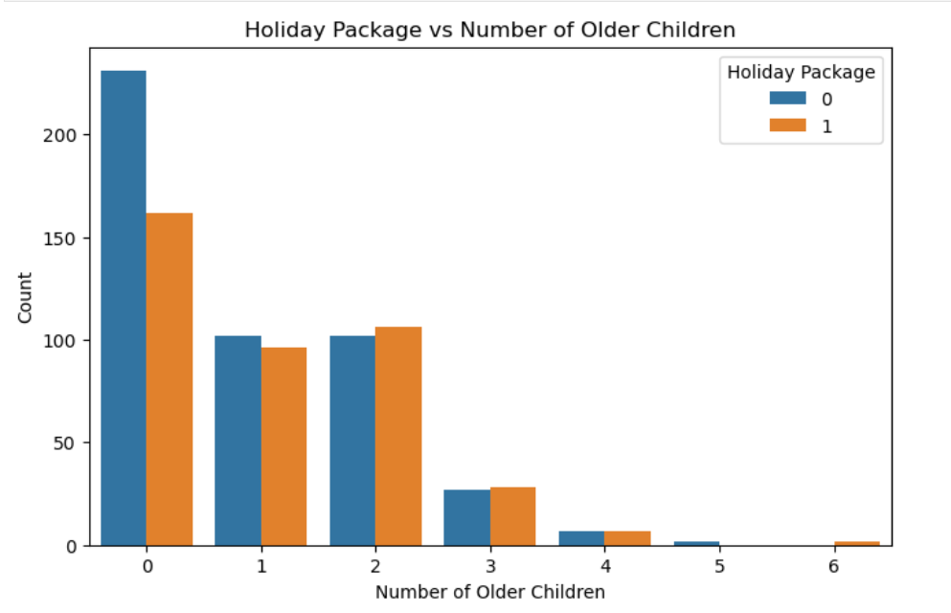
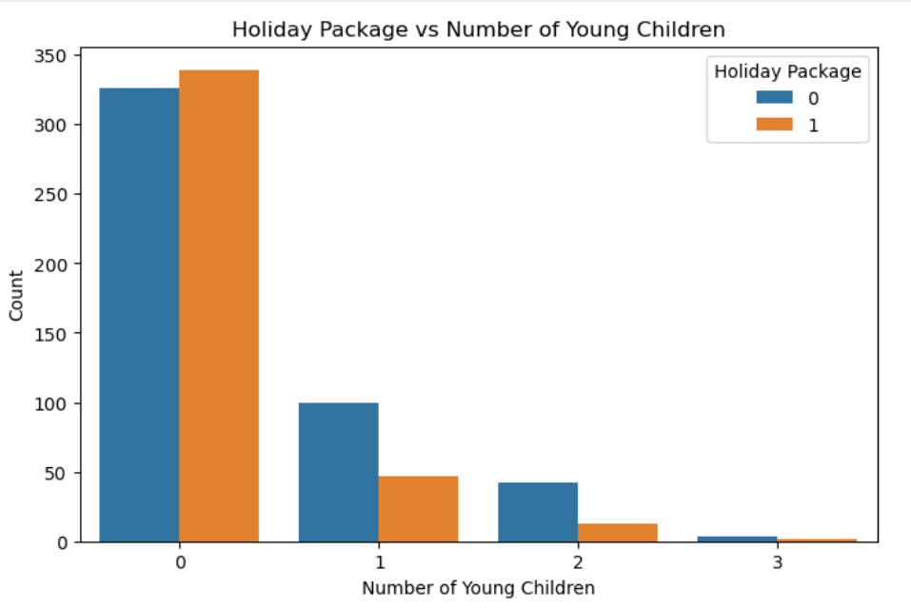
Exploratory Data Analysis (EDA)
Bi variate

Slide 9
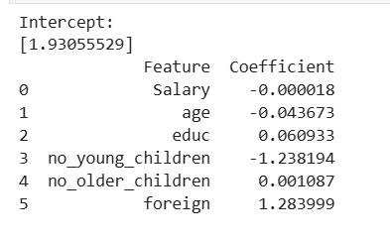
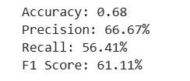
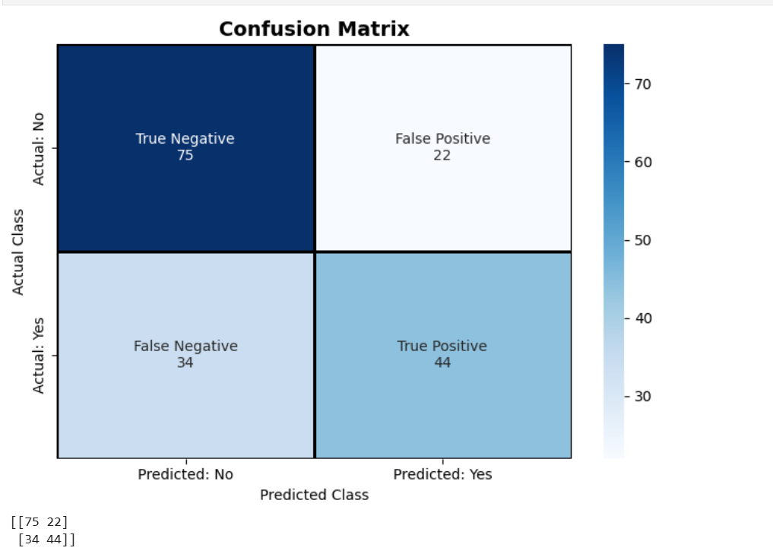
Logistic Regression Model
A sample employee with a salary of ₹60,000, aged 35 years, having 14 years of education, one young child, one older child, and not being a foreign employee was evaluated using the Logistic Regression model. The model estimated a purchase probability of 25.63% and classified the employee as "Will Not Purchase"

Slide 10
Results:
Significant Predictors:
Salary significantly influences the likelihood of purchasing a holiday package .
Age is a significant predictor, with increasing age associated with a lower probability of purchase (p < 0.001).
Number of Young Children has a significant negative impact on purchase decisions (p < 0.001).
Foreign Status is a significant positive predictor of holiday package purchase (p < 0.001).
Business Interpretation:
The analysis suggests that the travel agency should primarily target younger employees, employees with relatively lower salaries, employees with fewer or no young children, and foreign employees, as these factors significantly influence holiday package purchases. Education level and the number of older children were not found to significantly affect purchase decisions and need not be prioritized for customer targeting.

